Slide 1
Dependency Injection and Inversion of Control
Course “Spring – first touch”
Section 2

Slide 2

Do you know
Dependency Injection (DI)
Inversion of Control (IoC)
Do you write code
using this things

Slide 3
Agenda
Coupling
Object dependencies
Hollywood Principal
Dependency Injection pattern
Inversion of Control Containers

Slide 4
Three problems
Application size
Integration
Configuration

Slide 5
Addressed problem
Application size
Integration
Configuration

Slide 6

Application size matters
Console app with
  10 – 20 classes
OR
Web app with
  1000 – 10000 classes

Slide 7
When application size grows up
More classes
More dependencies
Hard to handle dependencies
Need mechanism for dependency handling

Slide 8
Definition
In computer science, coupling or dependency is the degree to which each program module relies on each one of the other modules.

Slide 9
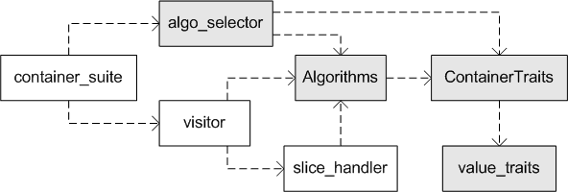
Class dependencies

Slide 10
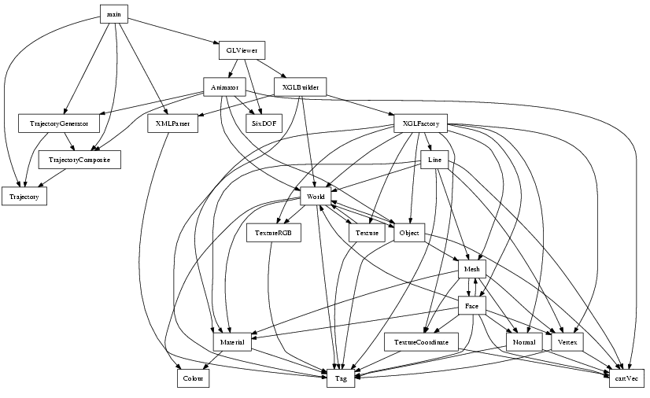
Dependencies hell

Slide 11
Hard coupled components
public class ProcessorImpl
implements Processor {
private Downloader downloader;
public ProcessorImpl() {
downloader = new DownloaderImpl();
}

Slide 12
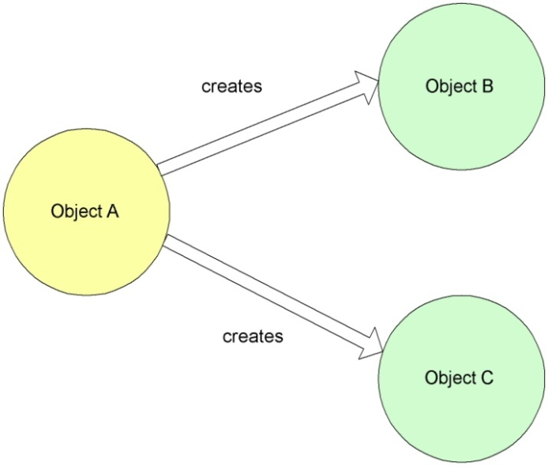
Object directly create another

Slide 13
Bad practice
public class ProcessorImpl {
public ProcessorImpl() {
String url = “someURL”;
Downloader downloader =
new DownloaderImpl(url);
}
}
Interface
Realization
Parameters

Slide 14

Bad practice
Create hard coupled components

Slide 15

Best practice
Create loosely coupled components

Slide 16
Best practice
public class ProcessorImpl {
private Downloader downloader;
public ProcessorImpl(Downloader downloader) {
this.downloader = downloader;
}
}
Only Interface
No Realization and Parameters information!

Slide 17
Program with interfaces
public class ProcessorImpl
implements Processor{
private Downloader downloader;
private Parser parser;
public List<Bookmark> loadBookmarks(){
downloader.download();
parser.parse();
}

Slide 18
Loosely coupled components
Components depend on abstractions
Abstractions not depend on details
Details depend on abstractions
Please, translate to Java notation
(object, interface, class, …)

Slide 19

Loose coupling – how to?
With minimal effort
Using a least intrusive mechanism
Without adverse functional implications

Slide 20
Hollywood Principal
aka “don’t call us, we’ll call you”
  Components should not be explicitly requested/instantiated
  Components will be provided as needed
aka Inversion of Control

Slide 21

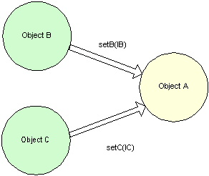
Non-IoC versus IoC
Non Inversion of Control approach
Inversion of Control approach

Slide 22
Dependency Injection
Dependency injection (DI) is a term used to resolve component dependencies by injecting an instantiated component to satisfy a dependency.

Slide 23
Forms of DI
Constructor Injection
Setter Injection
Interface Injection

Slide 24
Constructor Injection
public class ProcessorImpl implements Processor {
private Downloader downloader;
private Parser parser;
public ProcessorImpl(Parser parser) {
this.parser = parser;
}

Slide 25
Setter Injection
public class ProcessorImpl implements Processor {
private Parser parser;
public setParser(Parser parser) {
this.parser = parser;
}

Slide 26
Interface Injection
public class ProcessorImpl implements Processor {
@Autowired
private Parser parser;

Slide 27
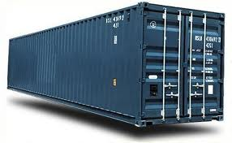
DI implementation
Dependency Injection pattern implementation
=
Inversion of Control container

Slide 28
What it is?
Inversion of Control container
=
Framework

Slide 29
Inversion of Control Containers
Implements Dependency Injection pattern
Realize Hollywood Principal

Slide 30
IoC Container responsibilities
Instantiating application objects
Configuring objects
Assembling the dependencies between objects
Etc.

Slide 31
IoC Containers provides
Centralized
and automated configuration;
Life cycle management
and wiring of Java objects.

Slide 32
IoC Container examples
Spring
Guice
PicoContainer
etc.

Slide 33
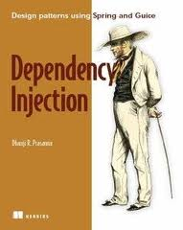
Future reading

Slide 34

Any Questions?

Slide 35
References
http://martinfowler.com/articles/injection.html
http://www.springsource.org/
http://code.google.com/p/google-guice/
http://www.picocontainer.org/

Slide 36

Practice 1

